Slide 1

Chapter 6
Human Population and Environment

Slide 2
Introduction
In earlier civilisation population control was there due to droughts, epidemics etc. In the 14th century 50% of the population in Asia and Europe were killed due to outbreak of plague.
Owing to scientific and technological development , people are not well equipped to adapt to difficult environmental conditions and tremendous growth of medical sciences has lead to increased life expectancy.
The population of World was 2.5 billion in 1950 has increased to 6.7 billion by 2008 and is expected to increase to 8 billion exerting huge pressure on the resources and leading towards a global environmental crisis.
As a result of rapid growth in population majority of people live in undesirable conditions devoid of basic facilities such as sanitation, education, health facilities etc.

Slide 3
Population Growth
Increase in the number of individuals of human beings .
Population growth rates might have declined, but in 2013 every 60 minutes there are another 8,000 people in the world: about 75 million every year.
In demography, population growth is used informally for the more specific term population growth rate and is often used to refer specifically to the growth of the human population of the world.
The world population grew from 1 billion to 7 billion from 1800 to 2011. During the year 2011, according to estimates, 135 million people were born and 57 million died, for an increase in population of 78 million.

Slide 4
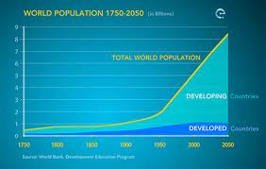
Population Explosion
The rapid increase in population which outstrips the growth of national income and retards the per capita income.
The population of the world was 2.5 billion in 1950 has increased to 6.7 billion by 2008 and is expected to about 8 billion by 2020.

Slide 5
By definition, overpopulation is a condition where the number of organisms exceeds the carrying capacity of their habitat.
Overpopulation leads to scarcity of resources and economic inflation. The world population has crossed 7 billion and we are having to deal with the adverse effects of this excessive growth. The day is not far when we won't be left with sufficient resources to meet life's basic needs.
Overpopulation is a serious issue, more serious than it seems to be. To nip it in the bud, we need to understand its root causes.

Slide 6
World Population Milestones
 | 1 billion in 1804
 | 2 billion in 1927 | (123 years later)
 | 3 billion in 1960 | (33 years later)
 | 4 billion in 1974 | (14 years later)
 | 5 billion in 1987 | (13 years later)
 | 6 billion in 1999 | (12 years later)
 | 7 billion in 2011 | (12 years later)

Slide 7
Understanding Population Patterns
The study of the trends in human population is called demography. Three main factors decide the increase or decrease in population.
Birth rate – It is defined as number of births per thousand people in a geographical area. Birth rate is decline on an average and it will be 2 by 2050 from 2.56 children per women. This level varies among developing and developed countries.
Death rate – It is defined as number of deaths per thousand people in a geographical area. The advancement in the field of medicines have resulted in lesser no. of deaths leading to lower in death rate. This rate can change unexpectedly due to diseases, wars and other catastrophes.
Migration – It is defined as the rate of population change for a specific area which is also affected by the movement of people into and out of the area. Many developed countries of the world are experiencing an increase in population because of the continuing arrival of immigrants, people from developing countries to find better job.

Slide 8

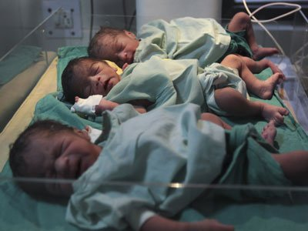
Causes of Population Growth
Conquest of diseases
Improvement in Public Health
High infant mortality
Poverty
Preference for male child
Custom of early marriages
Illiteracy

Slide 9
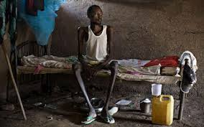
Conquest of diseases
Population has shown a remarkable increase during the past few decades.
Advancement in medical facilities
Awareness about nutrition, vaccinations, better health practices

Slide 10
Improvement in Public sanitation
Public sanitation has been increased.
Intensity of epidemic diseases such as cholera, typhoid ,dysentery has been lowered due to awareness, availability of clean water and better sanitation.
Before 1990 , less than 50% of population had access to safe drinking water but after wards it is increased to 75%.

Slide 11
High Infant mortality
In developing countries this rate is high but in the developed countries this rate is low because of safe drinking water and good medical care.
Poverty
More children means more hands to work , more earning . But due to lack of money, no proper education, no awareness of various family planning measures.
Preference for sons
Due to illiteracy and old traditions, in many families the desire of son and often more sons results in more children. Another reason that encourage people for sons over daughters is the prevalence of the dowry system.

Slide 12
Early marriages
Early marriages, marriage of young children before they attended a marriageable age leads to more children
Illiteracy
lack of awareness of family planning measures, they have no access to information regarding family planning and hence largely involve in growth of population.

Slide 13
Consequences of Population Growth
Increase in population has lead to several socio-economic problems.
More deforestation activities arising to meet the requirements of fuel wood, agriculture, settlement and also for industrial establishments.
Excessive exploitation of natural resources causing ecological imbalance in nature.
The indiscriminate cutting of trees for agricultural expansion and timber products has lead to the degradation of watersheds affecting the water catchment areas.
Due to population pressure, water resources are exploited more for various uses including domestic, livestock and industrial use.
Population growth affects the natural resource availability. It causes increased demand for food, water, arable land and other essential materials, such as firewood.

Slide 14
Unemployment problems of serious dimension both in urban and rural
areas leading to reduced per capita earning, poverty, etc.
Hunger deaths - because of reduced per capita food availability and
poor distribution of food.
Acute shortage of medical facilities including qualified doctors,
medicines, dispensaries, modern health care facilities etc - due to high
population.
Shortage of education facilities including schools, colleges, qualified
teachers.
Serious shortage of power and problems connected with its distribution,
Increased inflation.

Slide 15
Increased borrowings from international organisations.
Reduced care of young ones leading to increased child health problems as well as vulnerability of children to many diseases.
Reduced health care to mothers.
Difficulties encountered in implementation of all national and state developmental programmes.
Increased government expenditure.
Increased density of population.

Slide 16
Variations among nations
The rate of population growth are depended on climatic conditions and reproductive potential of the countries and may vary among countries and also between different regions of the same country.
Some countries experience negative population growth, especially in Eastern Europe mainly due to low fertility rates, high death rates and emigration.
In Southern Africa, growth is slowing due to the high number of HIV-related deaths.
Some Western Europe countries might also encounter negative population growth. Japan's population began decreasing in 2005.
It has been observed that some developed countries have high population growth rates, this may be due to the effect of high immigration of people from developing countries.

Slide 17
Growth rates of the world's most populous countries
Rank | Country | Population 2010 | Population 1990 | Growth (%) 1990–2010
 | World | 6,895,889,000 | 5,306,425,000 | 30.0%
1 | China | 1,341,335,000 | 1,145,195,000 | 17.1%
2 | India | 1,224,614,000 | 873,785,000 | 40.2%
3 | United States | 310,384,000 | 253,339,000 | 22.5%
4 | Indonesia | 239,871,000 | 184,346,000 | 30.1%
5 | Brazil | 194,946,000 | 149,650,000 | 30.3%
6 | Pakistan | 173,593,000 | 111,845,000 | 55.3%
7 | Nigeria | 158,423,000 | 97,552,000 | 62.4%
8 | Bangladesh | 148,692,000 | 105,256,000 | 41.3%
9 | Russia | 142,958,000 | 148,244,000 | -3.6%
10 | Japan | 128,057,000 | 122,251,000 | 4.7%

Slide 18
Factors affecting Variation of Population
Age of human settlement in the area: The area where human settlement have existed for a very long time are now recording extremely high rate of population growth compared to area where settlement are relatively new.
Means of transport and communication: Area that can be easily accessed by air, land and water are always densely populated due to ease with which trade and commercial activities can be carried on in theses areas. These areas are also utilized for agricultural and industrial purposes, which provide high job opportunities and more populations.
Cultural factors : Area occupied by nomadic tribes are always sparsely populated since they do not indulge in permanent agriculture and settlement and support their families by gathering wild fruits and other forest products and move on to newer places once resources get exhausted.
Kind of Soil: Areas that have abundance of fertile soil are more populated. Infertile and desserts are usually less populated compared to area around river valley.

Slide 19
Climatic conditions: Region with moderate climate are usually densely populated than regions that experiences extreme climatic conditions. Ex like Canada extremely low temperature and Rajasthan because of very high temperature are less populated.
Natural resources: Area having rich wealth of natural resources such as coal, water and forest are more populated. These resources help in the development of trade , commerce and industry.

Slide 20
Birth control
High population growth adversely affects the production of goods and products , availability of natural resources and hence the economy of the country.
There is an increase in 3 humans per second because of every 2 people that die in a second, five children are born. Such a high rate is called population explosion.
Birth rate can be reduced by adopting various birth control methods as follows
Temporary methods
Permanent Methods

Slide 21
Birth Control methods
Temporary Methods
Mechanical methods
Diaphragm
Intrauterine Devices
Chemical methods
Natural methods
Permanent Methods
Sterilization methods
Abortion

Slide 22




      Family Welfare Programme
      Family welfare programme is different from the family planning since it does not involve the methods of family planning but also concerned with providing relevant education and awareness. It is a powerful tool to check the population growth in less developed countries, it can cause lowering of birth rate.
      The success of the family welfare programme depends upon public awareness, education of women, proper family counseling and easy availability of the means of birth control. Better medical facilities and nutritional programmes also support such programmes.

Slide 23
Need of family welfare programme
Decentralised area-specific planning based on need assessment.
Emphasis on improved access and quality of services to women
and children.
* Providing special assistance to poorly performing states/districts to minimise the differences in performance.
* Creation of district-level databases on quality, coverage and impact indicators for monitoring the programme.

Slide 24
In response to our phenomenal population growth, India seriously took up an effective Family Planning Program which was renamed the Family Welfare Program. Slogans such as ‘Hum do hamare do’ indicated that each family should not have more than two children.
Informing the public about the various contraceptive measures that are available is of primary importance.
Many countries like China has imposed some penalties for the families having excess no. of children, such as
Return of bonus for the first child if second child is born.
Payment of a tax for a second child.
Payment of higher prices for food for a second child.
Denial of maternity leave and paid medical expenses after first child.

Slide 25
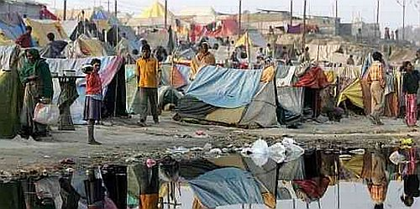
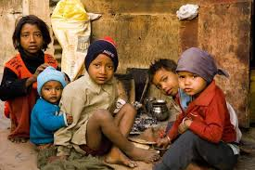

Slide 26
Population and poverty
Poverty in India is widespread, with the nation estimated to have a third of the
world's poor. In 2010, the World Bank reported that 32.7% of the total Indian
people fall below the international poverty line.
Because of India's rapid population growth rate, even that advance, however,
has not been sufficient to reduce the absolute number of poor, which increased
from around 200 million in the 1950s to 312 million in 1993-94.
This leaves India with the largest concentration of poor people in the world,
particularly in the villages — where 60 percent of all Indians live.

Slide 27
